Slide 1
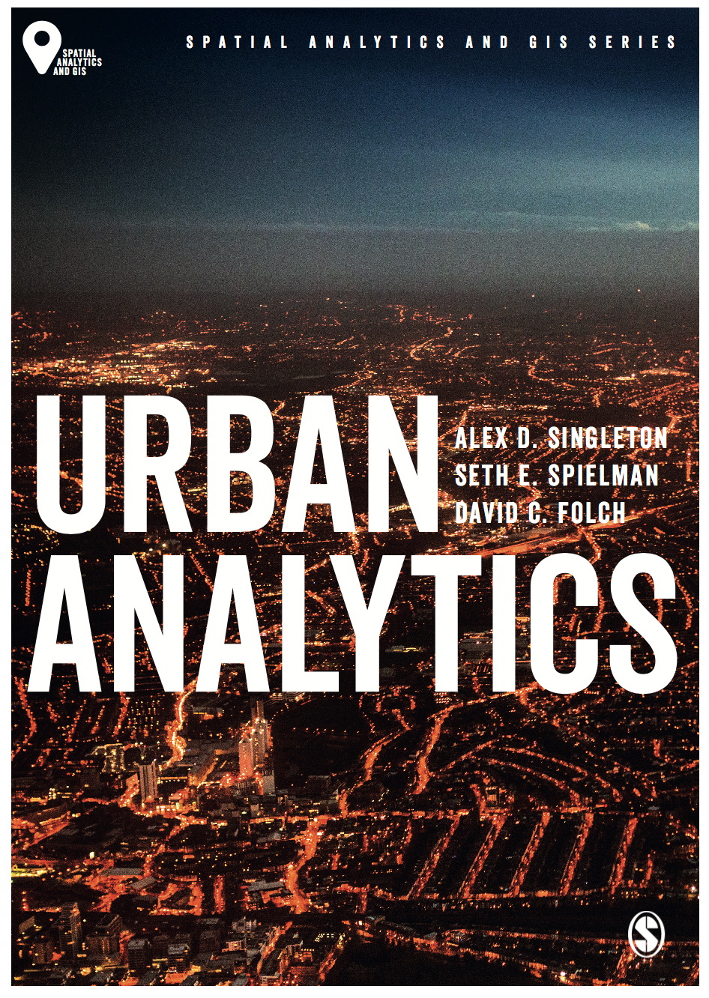
New Forms of Data
Alex D Singleton, Seth E Spielman, David C Folch (2017) Urban Analytics. London: Sage.

Slide 2
Learning Objectives
Sensors and social media complement traditional sources and are generating an increasing amount of new data about urban areas.
Example methods used within urban areas to “sense” the city

Slide 3
Real-time Data
Real-time data
Generated by sensors embedded within the fabric of urban areas
Volunteering of geographic information by people flowing through these spaces
Often high spatio-temporal granularity, although also less representative and comprehensive than traditional sources
Volunteered geographic information
Contributed by people – e.g. Twitter
Location reference
Passive & Active Data Generation

Slide 4
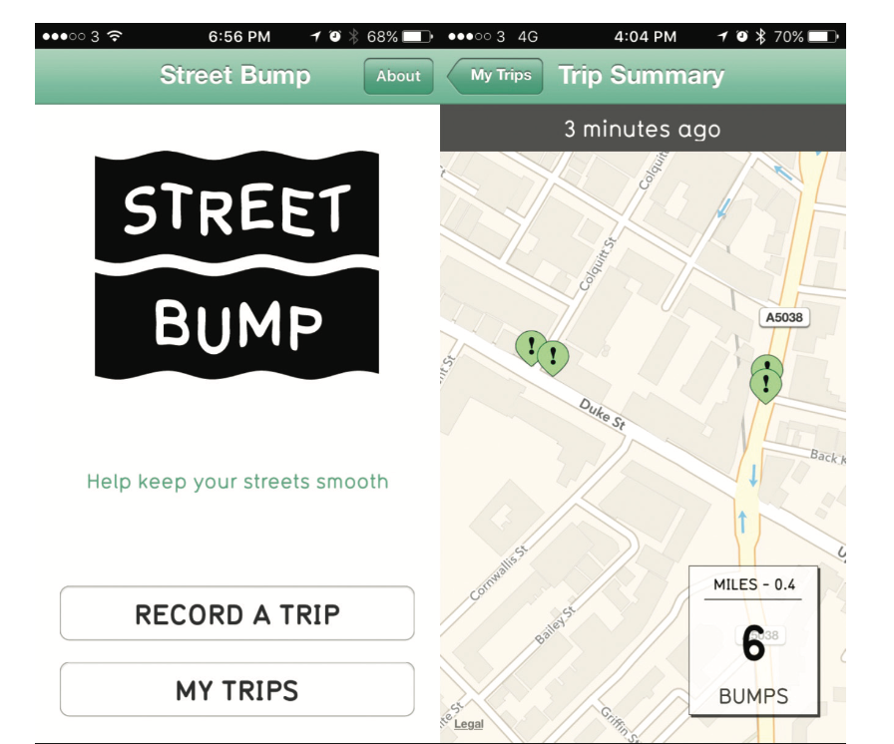
Example of Urban Spatial Data Infrastructure
Boston Mayor’s Office of New Urban Mechanics
Accelerometer of the phone
Detect depressions
Stored on a remote server over Internet
Later analyzed
Remedial action taken
The Street Bump mobile app showing a number of bumps recorded along a street section
Source: Authors’ own; app provided by www.streetbump.org

Slide 5
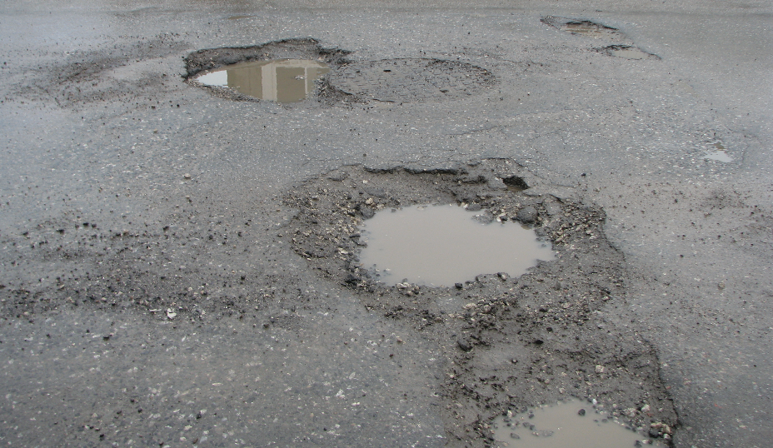
Example of Urban Spatial Data Infrastructure
What might be the potential sources of bias in the collected data?
Potholes in a road Source: Photograph by Michael Gil CC BY 2.0 (Flickr)

Slide 6
Passive Data Generation
Sensors that collect data passively – many different sorts
carbon dioxide (or other gases)
Temperature
Humidity
Noise
light etc
Multiple scales – city wide through to buildings

Slide 7
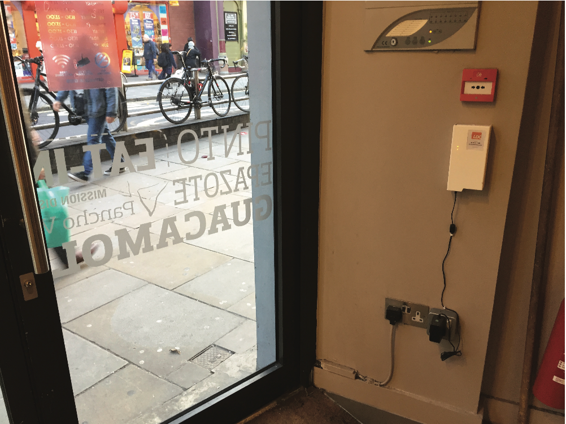
Passive Data Generation
Mobile passive data
Linked to cellular / mobile phones
Utilise WiFi or cell tower to estimate location
Many development platforms for phone apps also collect data
Ownership of these data typically private
But might use the data to create “free” services
E.g. Google routing optimised to avoid traffic congestion
An example of a SmartStreetSensor device within a shop window in London
Source: Local Data Company

Slide 8
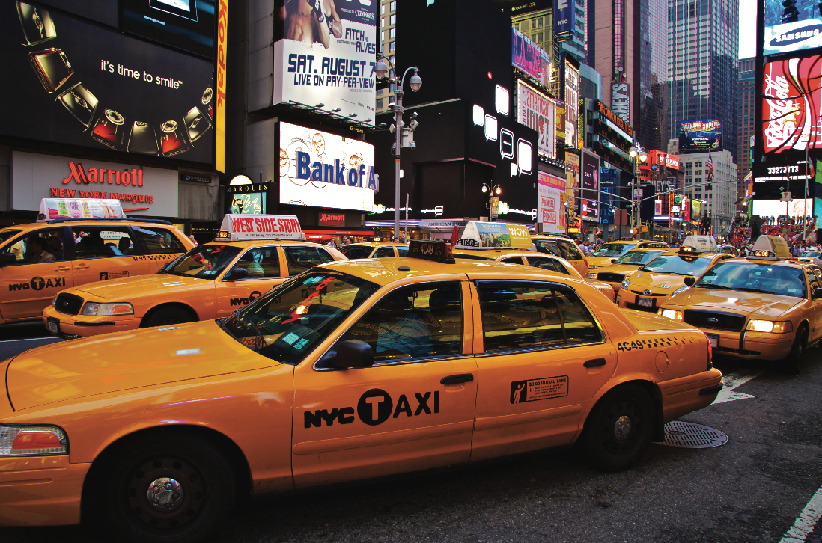
Passive Data Generation
GPS
In addition to cell phones, GPS receivers are also attached to other objects that move through urban areas such as taxis or buses
Photograph by Felix Morgner CC By-Sa 2.0 (Flickr)

Slide 9
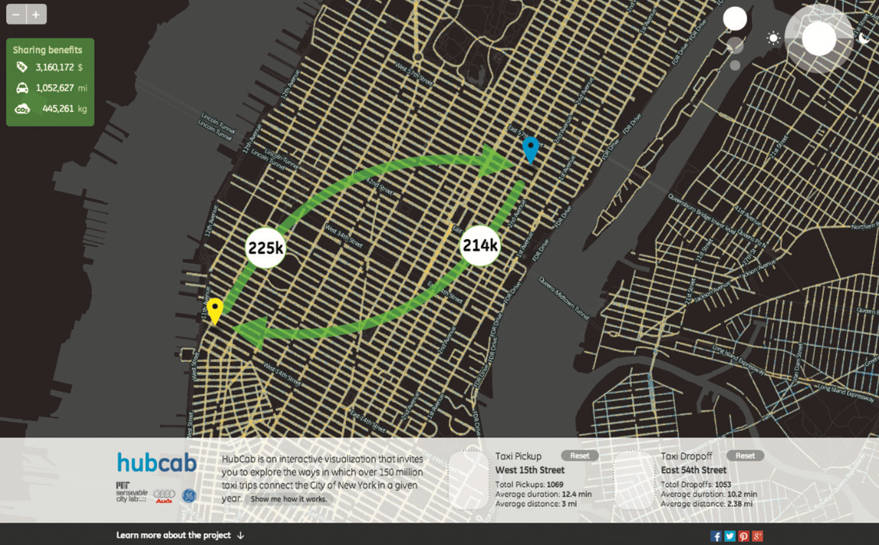
Screenshot of HubCab (www.hubcab.org), showing taxi flows and potential taxi-sharing benefits between two locations in Manhattan
Source: MIT Senseable City lab. Reproduced with permission.

Slide 10
Passive Data Generation
CCTV
Security monitoring related to policing activities, as store theft deterrent and detection, and for a variety of traffic management applications.
Coupling the live feeds with computer vision and streaming analytic techniques for pattern recognition, enables a variety of new applications
Automatic number plate recognition can detect uninsured vehicles
Road, bridge and tunnel charging
Pedestrian tracking

Slide 11
Active Data Generation
Numerous overlapping technology
Near Field Communication (NFC)
Bluetooth Low Energy (BLE)
Extended range; base of Apple iBeacon and open Google Eddystone
Enables two devices within close proximity to communicate through radio waves.
Often used in transport
Smart card ticketing systems
Shared bike scheme docking stations

Slide 12
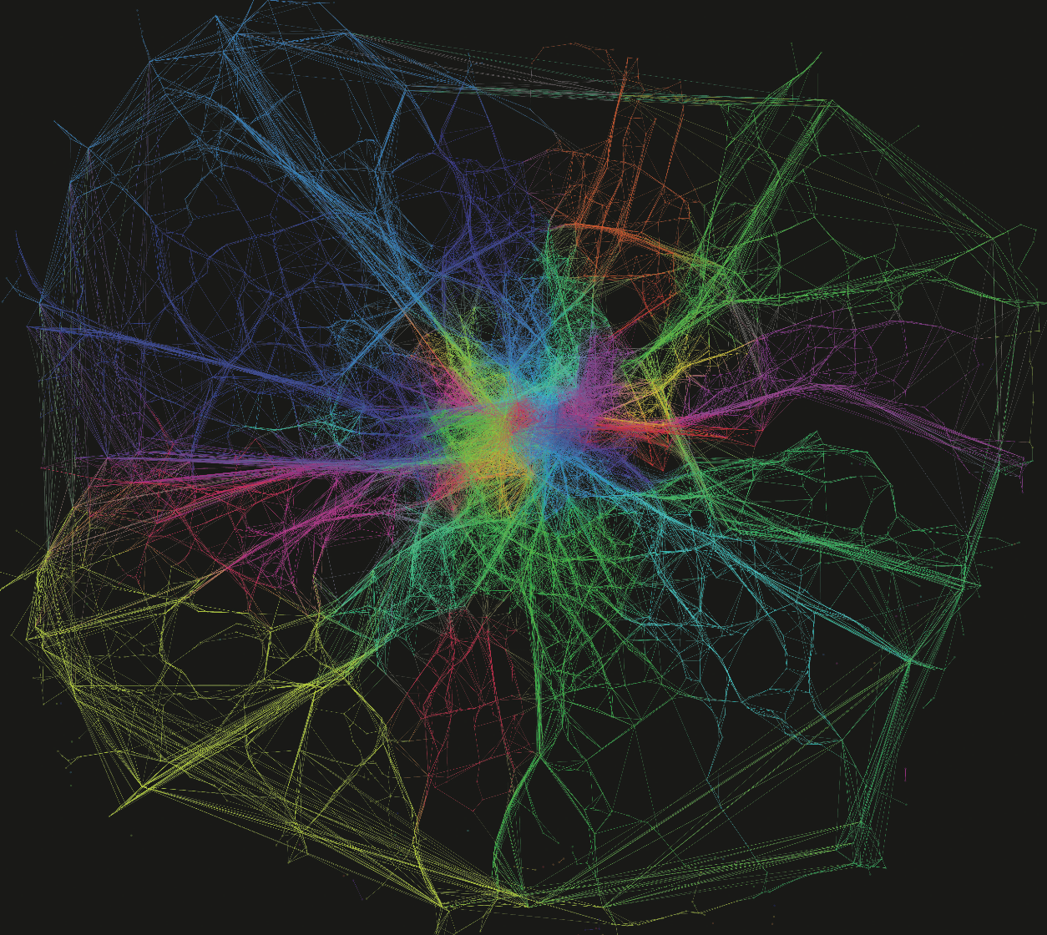
Active Data Generation: Example
London Underground network
Users swiping/hovering to enter and exit stations
1.3 billion trips within this network
Flows between the most popular destinations by origin, derived from a large dataset of morning peak Oyster Card trips
Source: Ed Manley, Centre for advanced Spatial analysis, UCL. reproduced with permission.

Slide 13
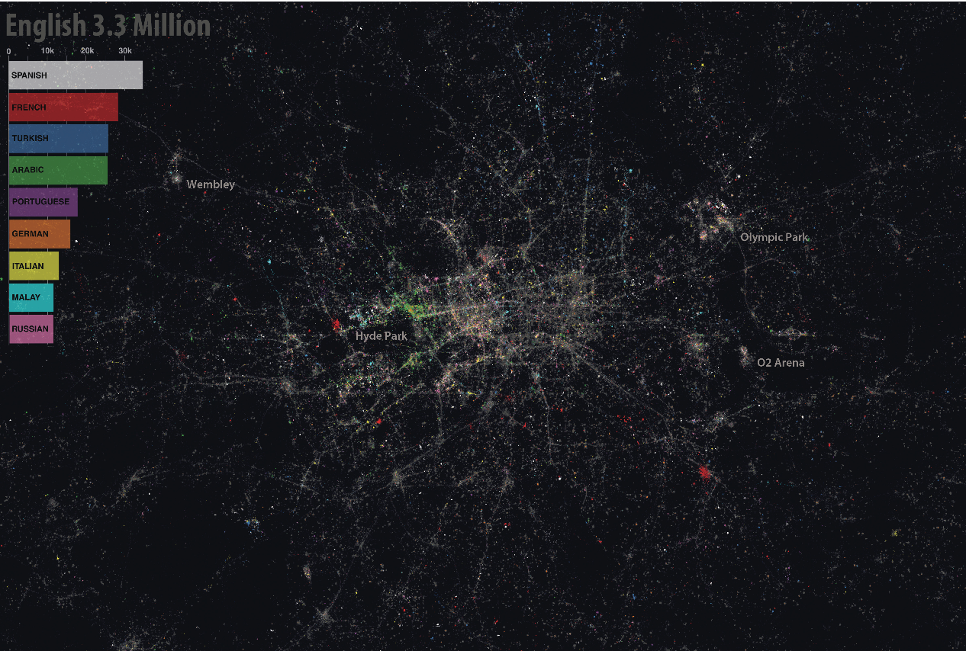
Active Data Generation: Example
Social media platforms are numerous
content is mostly user generated
functions: photography sharing, communications, social networks (personal and business), reviews, blogging, music, and video
The linguistic Twitter geography of Greater London Source: James Cheshire and Ed Manley, University College London. Reproduced with permission.

Slide 14
Conclusion
Real-time data
Passive
Active
Spatial Data Infrastructure
Mobile platforms
Sensors
WiFi

